Slide 1
Day 2 Classification Models
Today's agenda:
KNN Classifier
Random Forest Classifier
GBM Classifier

Slide 2
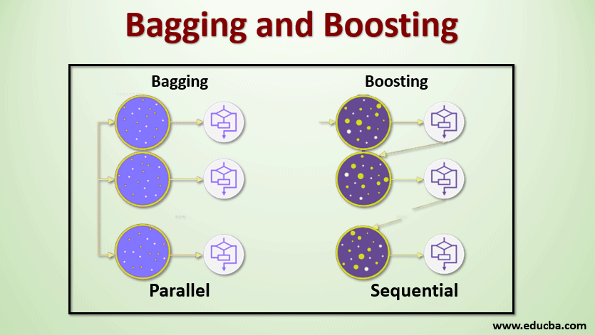
Boosting and Bagging

Slide 3
Bagging and Boosting: Similarities
Bagging and Boosting are ensemble methods focused on getting N learners from a single learner.
Bagging and Boosting make random sampling and generate several training data sets
Bagging and Boosting arrive upon the end decision by making an average of N learners or taking the voting rank done by most of them.
Bagging and Boosting reduce variance and provide higher stability with minimizing errors.

Slide 4
Bagging and Boosting: Differences
Bagging is a method of merging the same type of predictions. Boosting is a method of merging different types of predictions.
Bagging decreases variance, not bias, and solves over-fitting issues in a model. Boosting decreases bias, not variance.
In Bagging, each model receives an equal weight. In Boosting, models are weighed based on their performance.
Models are built independently in Bagging. New models are affected by a previously built model’s performance in Boosting.
In Bagging, training data subsets are drawn randomly with a replacement for the training dataset. In Boosting, every new subset comprises the elements that were misclassified by previous models.
Bagging is usually applied where the classifier is unstable and has a high variance. Boosting is usually applied where the classifier is stable and simple and has high bias.

Slide 5
Random Forest Classifier
Bagging

Slide 6

Random Forest

Slide 7
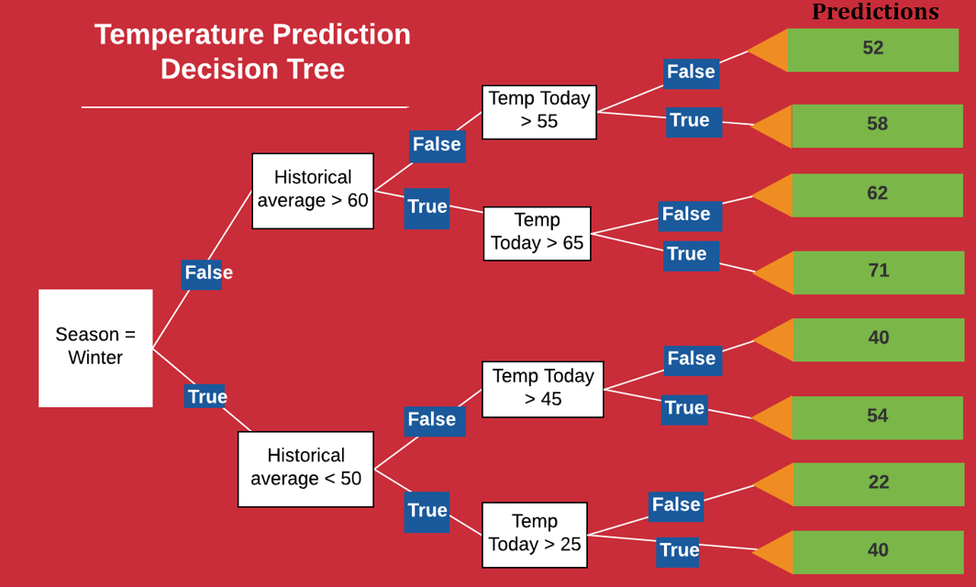
Notes:
We notice right away that each question (the white blocks) has only two answers: True or False. Moreover, for each True and False answer there are separate branches. No matter the answers to the questions, we eventually reach a prediction (shown in the green blocks).
For our example, the season is winter so we take the True branch. We said the historical average was 46, so the second question is also True. Finally, the third answer is True as the max temperature today was 43. Therefore, the final prediction is 40 degrees for the max temperature tomorrow, close to our guess of 44.

Slide 8
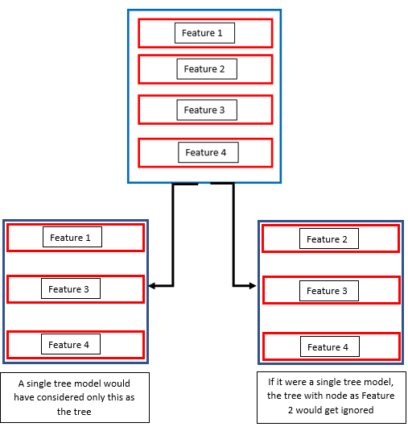

Slide 9
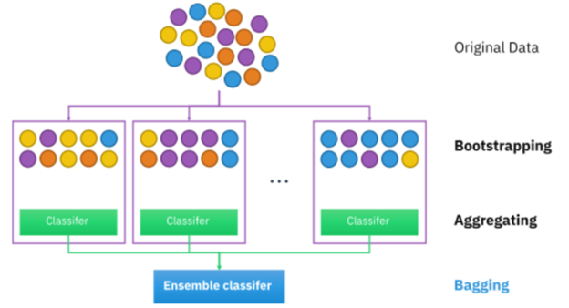

Slide 10
Random Forest Algorithm
Step 1: Pick at random K data points from training set.
Step 2: Build decision tree associated with thee K data points.
Step 3: Choose the number of N tree of trees you want to build and repeat Step 1 and Step 2.
Step 4: For every new data point, make each N trees predict the category to which the data point belongs and assign new data point to category that wins majority vote.
Important hyper parameters related to the above algorithm
Parameters that determine the predictive power of the model:
n parameters – This is the number of trees that will be built. It increases performance, makes predictions more stable but slows down the model.
max_features – maximum number of features random forest considers to split a node.
min_sample_leaf – minimum number of leaves to split an internal node.
Parameters that determine the speed of the model
n_jobs – how many processors the model can use.
random_state – makes the output replicable.
oob_score – random forest cross validation method.

Slide 11
Gradient Boosting Method
Boosting

Slide 12
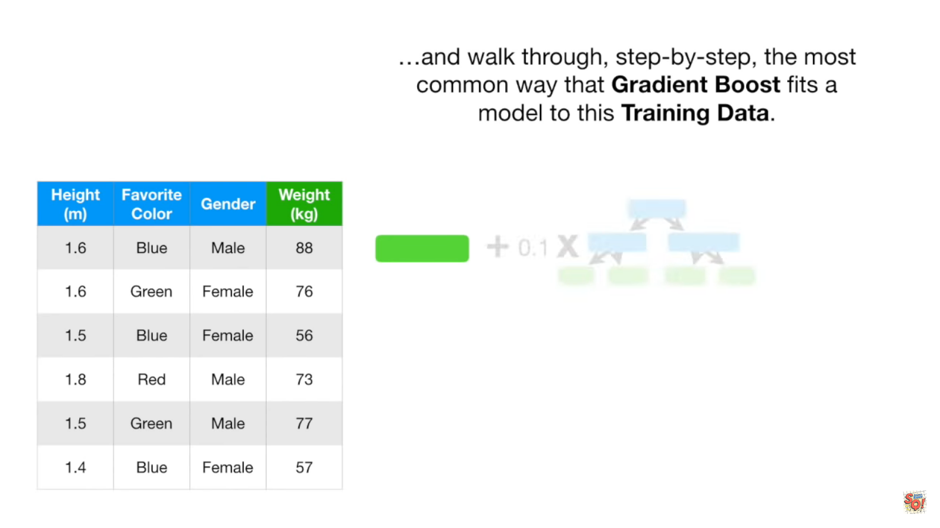

Slide 13
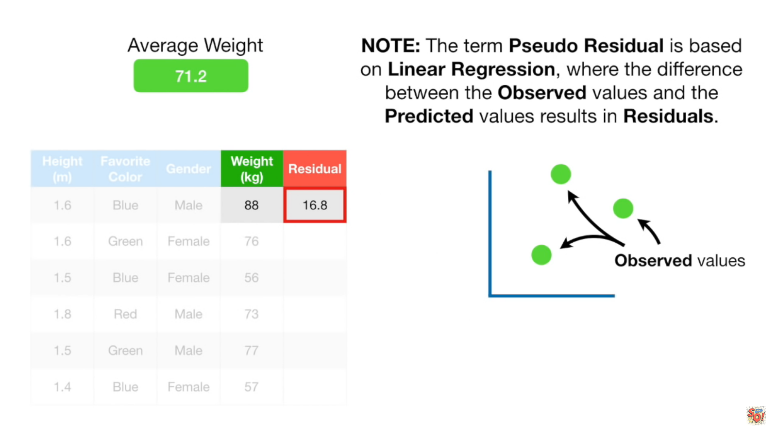

Slide 14
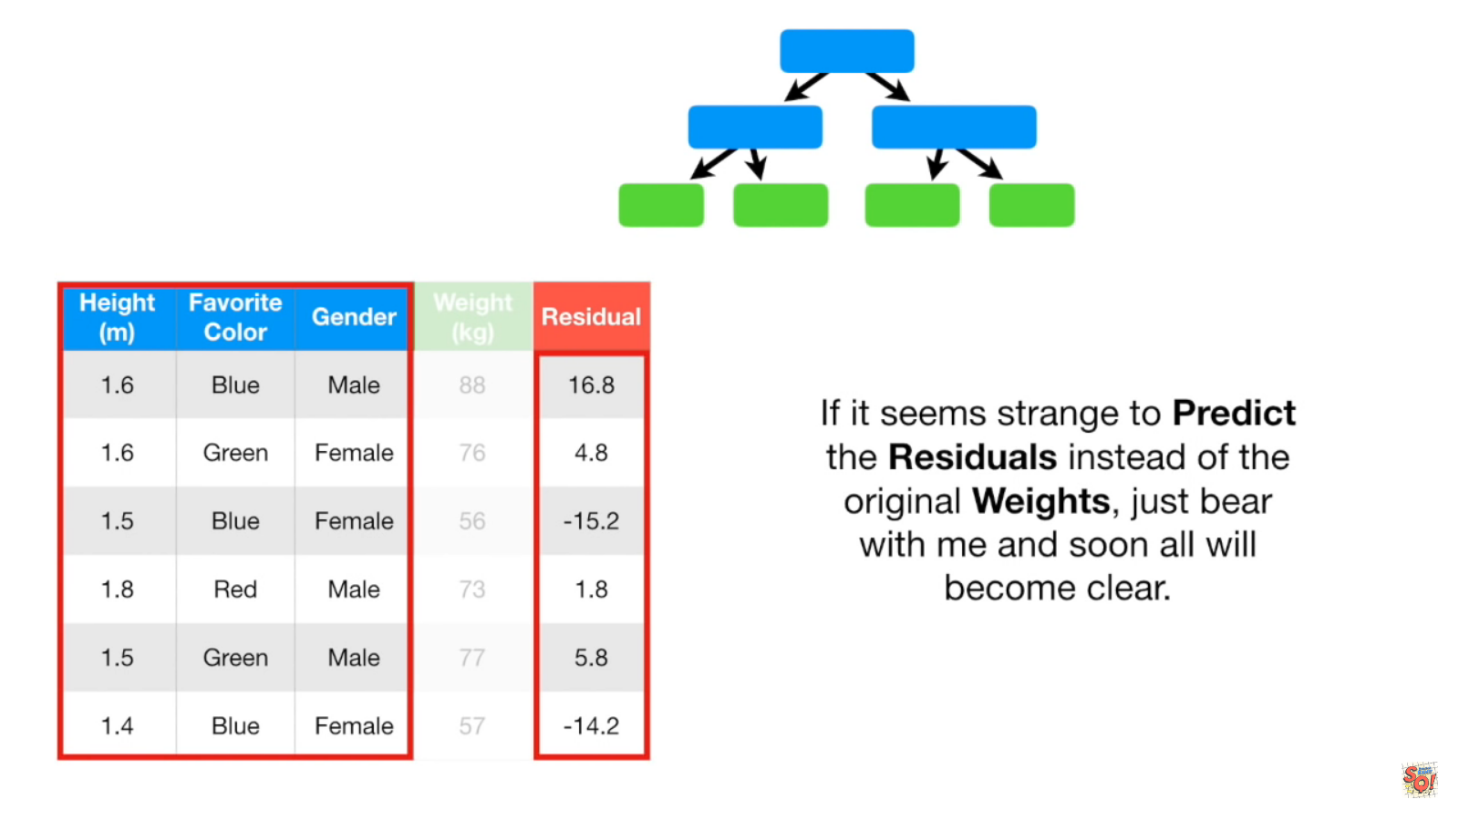

Slide 15
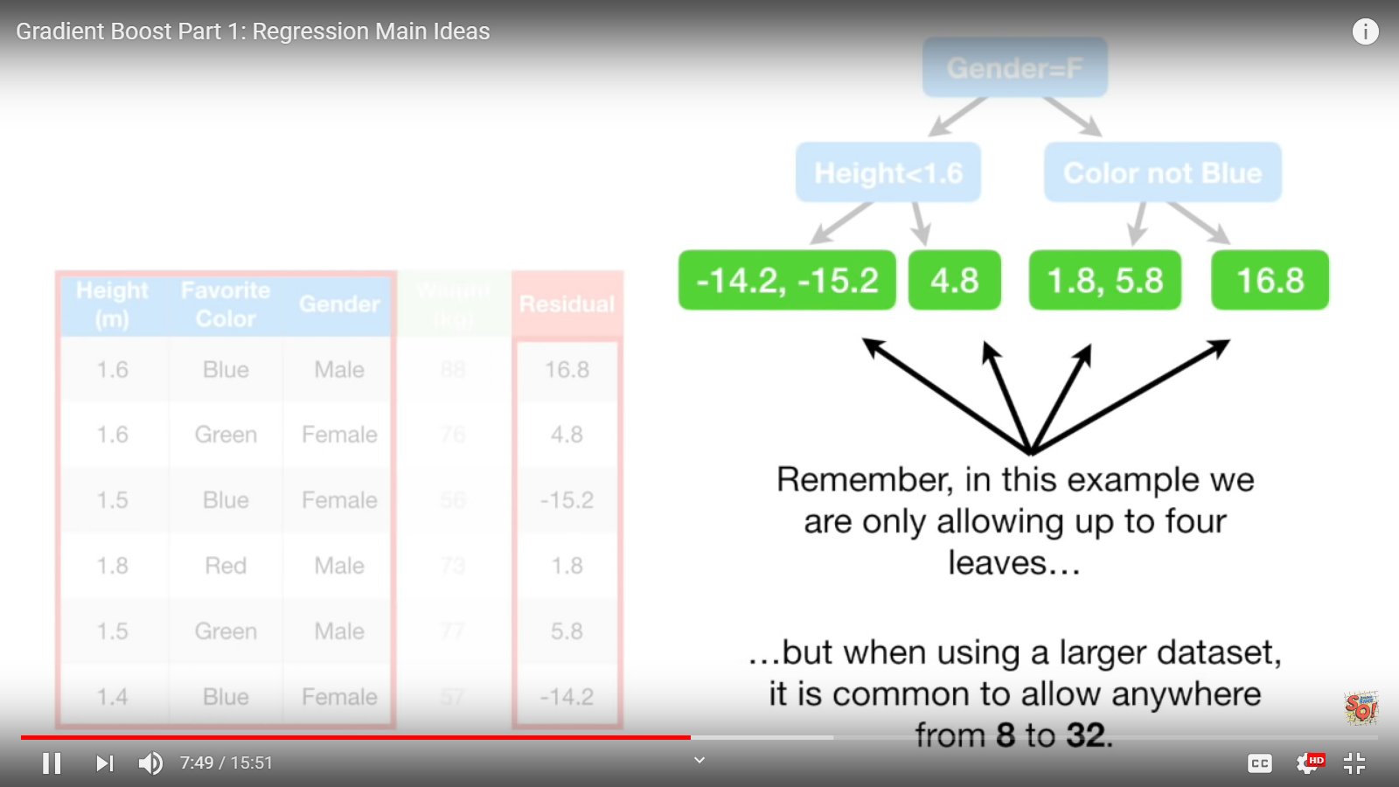

Slide 16
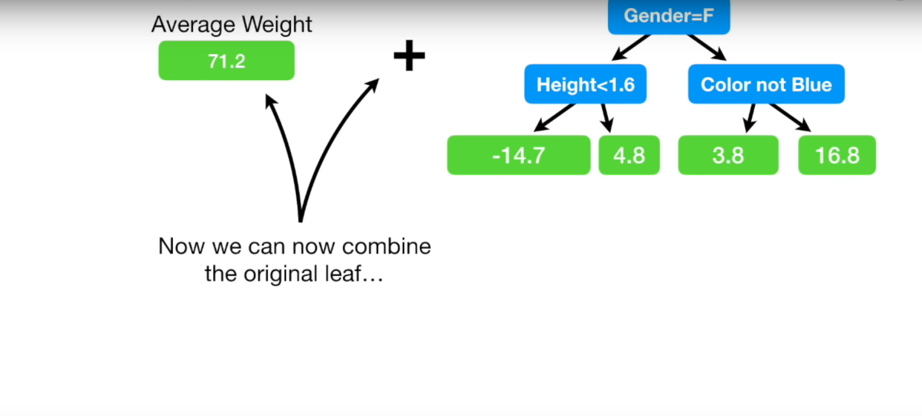

Slide 17
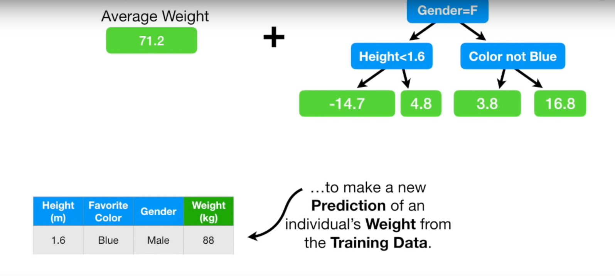

Slide 18
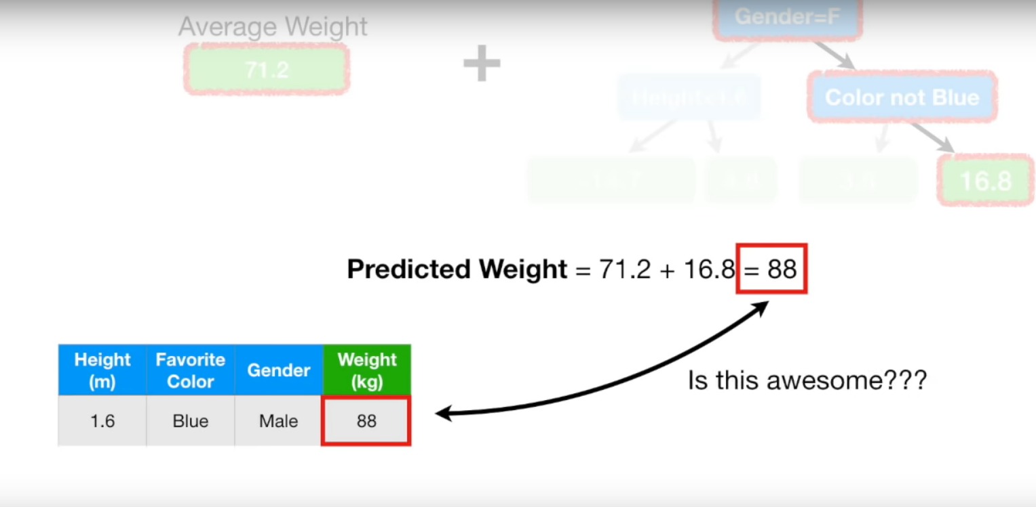

Slide 19
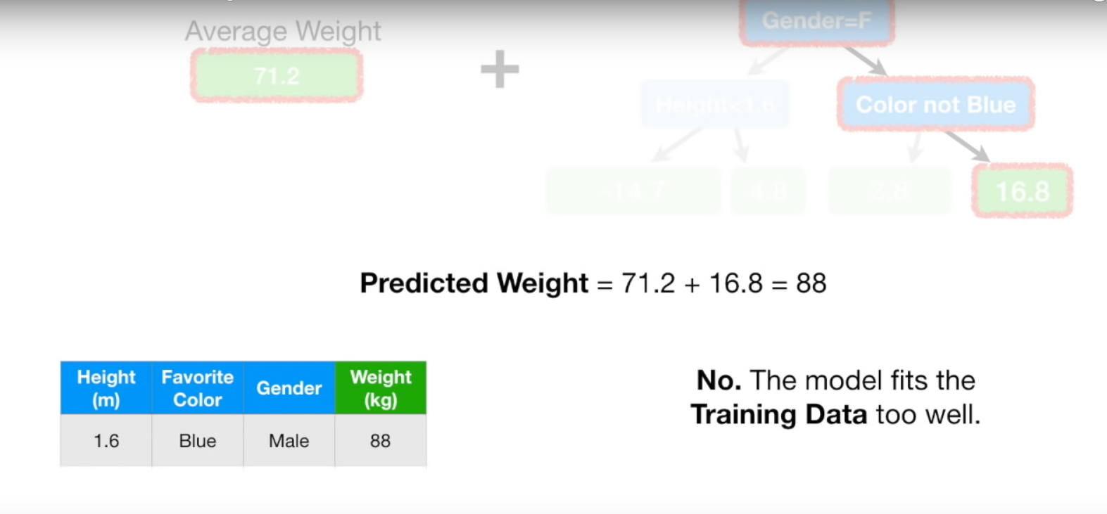

Slide 20
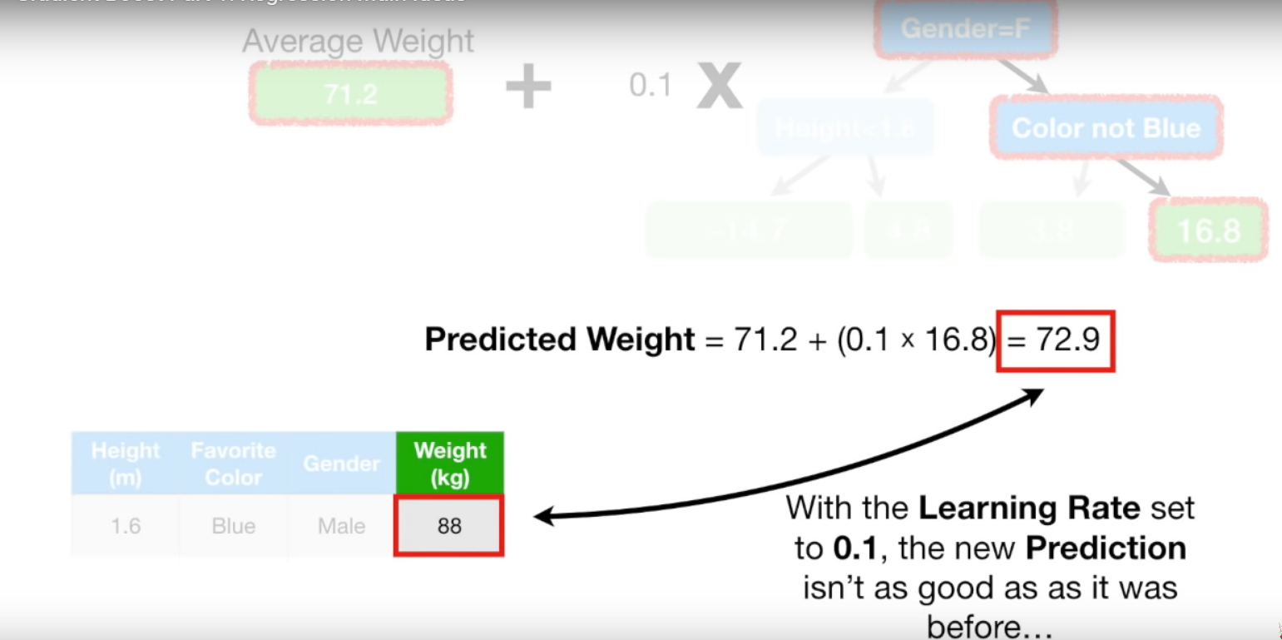

Slide 21
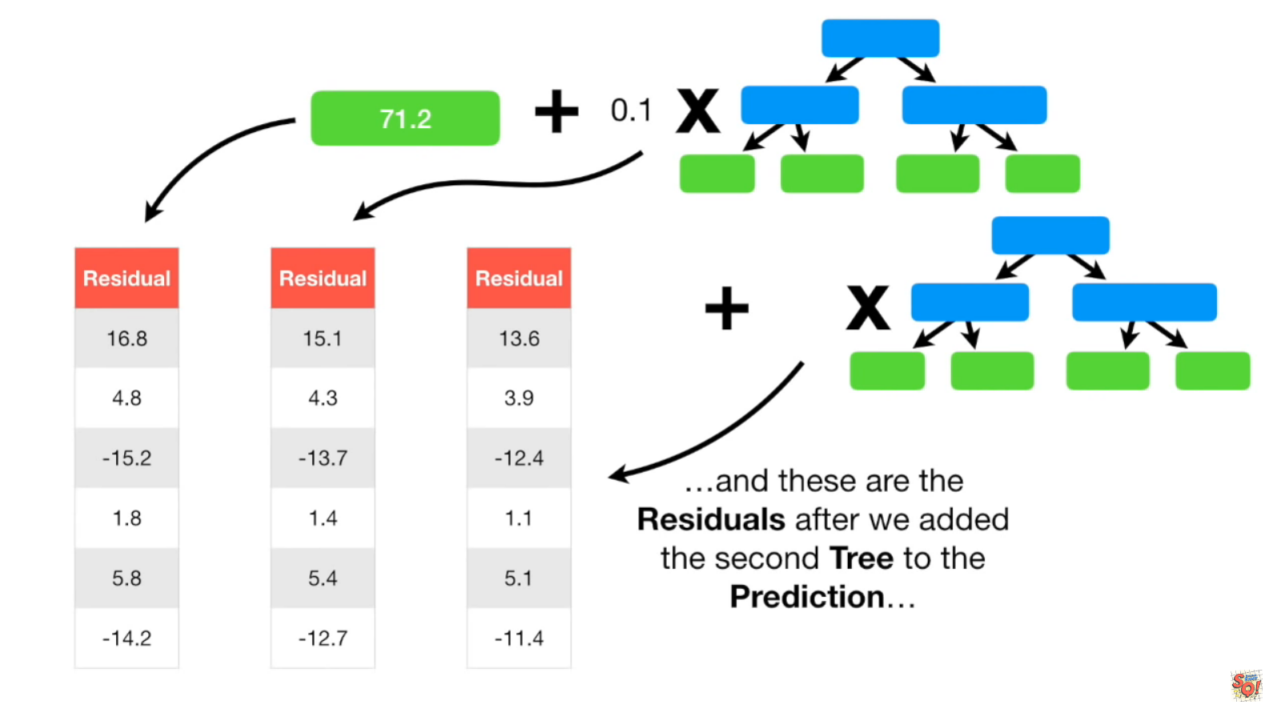

Slide 22
K-Nearest Neighbour Classifier

Slide 23
KNN Classification
- K-Nearest Neighbor Algorithm
- How does the KNN algorithm work?
- Eager Vs Lazy learners
- How do you decide the number of neighbors in KNN?
- Curse of Dimensionality
- Classifier Building in Scikit-learn
- Pros and Cons
- How to improve KNN performance?

Slide 24
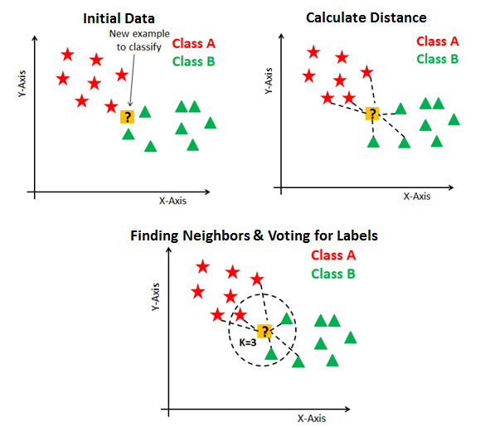
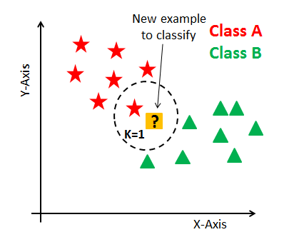
KNN
KNN is a non-parametric and lazy learning algorithm.
How does the KNN algorithm work?

Slide 25
Eager Vs. Lazy Learners
Ready, active and eager to classify unobserved data points
Curse of Dimensionality
KNN performs better with a lower number of features than a large number of features
Perform PCA to deal with this problem

Slide 26
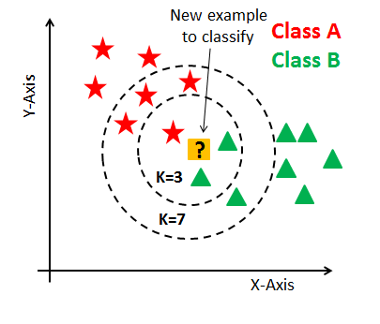
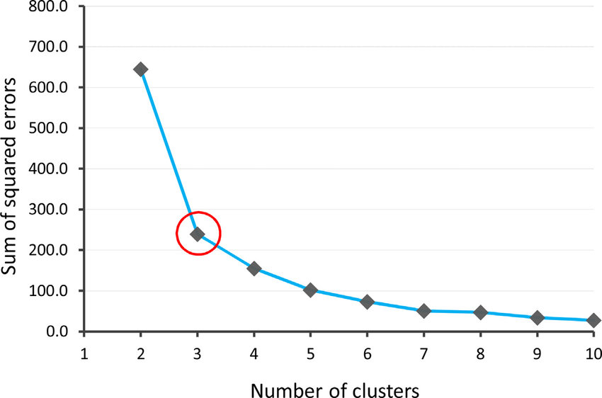
How do you decide the number of neighbors in KNN?
Notes:
the elbow method is a heuristic used in determining the number of clusters in a data set

